Slide 1
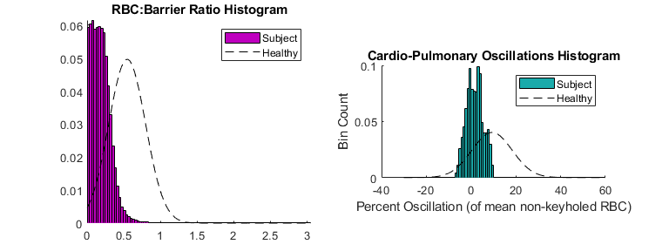
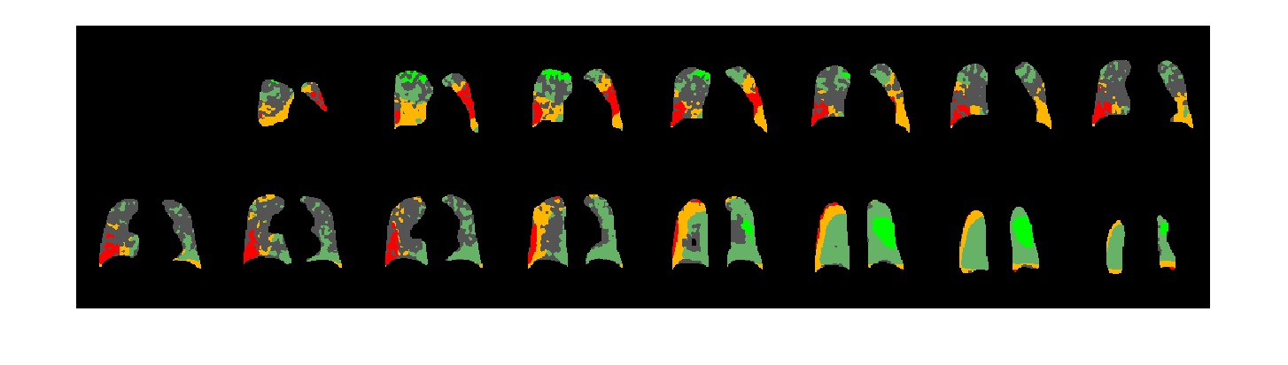
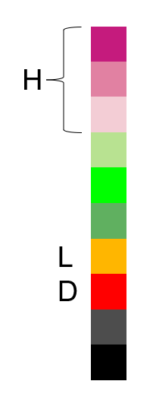
RBC Oscillation Analysis - Exploratory
Subject | 007-02-001A
Date | 2023-01-03
Mean oscillation Percent | 1.6573
Mean oscillation STD | 3.6657
Mean oscillation CV | 2.2118
MeanRBCMeasure | -2.2468
Total RBC SNR | 5.5583
% Low Oscillation (Red) | 7.4974
% Low Oscillation (Red-Orange) | 24.0536
% High Oscillation (Purple 1-3) | 0
% Low SNR (analysis ignored) | 40.1736
RBC:membrane | 0.13076
Binned Oscillations

